Slide 1
Healthy Respect drop-in at insert school or organisation.
In partnership with

Slide 2
What is a Healthy Respect Drop-in?
A safe place to talk about your sexual health and relationships.
Friendly, confidential chat
Free condoms (c:card), pregnancy testing and advice
Information and support
You can talk to your youth worker, insert name or your school nurse insert name.
All identities welcome

Slide 3
This services is confidential
This means the information a person shares is kept private.
If the service thinks you are being harmed or in danger, they may share some information to get you support.
Insert names will let you know if they need to share any info and who they will talk to.

Slide 4
Add Day and time
Add Room
Drop-in for a confidential chat
Or
Book at time to meet with your school
nurse

Slide 5
You can speak to your school nurse
About any health, relationships or sexual health worries
They offer the same confidentiality
How to speak to them:
Ask your Pupil Support Leader
Check if you have a lunch time school drop-in
Self-refer
Notes:
Donna

Slide 6
What other sexual health services can young people age 13+ access?

Slide 7
Get free condoms
At c:card points
Delivered to you by post.

Slide 8
Scan code or visit ccard.org.uk

Slide 9
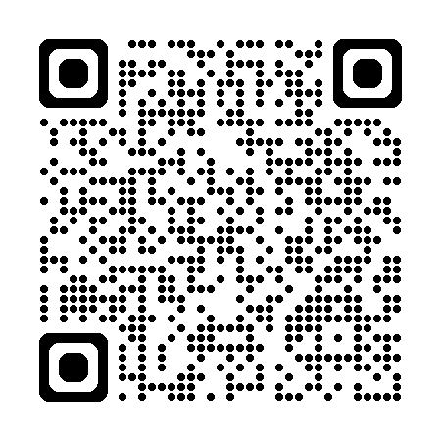
Get emergency contraception from any pharmacy or clinic
Scan code
or visit www.healthyrespect.co.uk/get-emergency-contraception/

Slide 10
Edinburgh
Healthy Respect + young people’s clinic at
Chalmers Centre (13-18)
Drop-in
Monday to Thursdays 3:30pm to 7pm
Fridays 1pm – 3:30pm
Find Chalmers
Pennywell All Care Centre
Drop-in
Fridays 1pm – 3.30pm
Scan code or visit bit.ly/services-lothian
Notes:
Individual page so schools can delete

Slide 11
Healthy Respect + young people’s clinic at

Slide 12
East Lothian
Healthy Respect + young people’s clinic at
Tranent Medical Practice
Drop-in
Tuesdays, 4:00pm to 5:00pm.
Scan code or visit bit.ly/services-lothian
Notes:
Individual page so schools can delete

Slide 13
Healthy Respect + young people’s clinic at Tranent Medical Practice

Slide 14
Midlothian
Healthy Respect + young people’s clinic at
Croft Street, Dalkeith
Drop-in
Tuesdays, 4pm – 7pm
Fridays, 1pm – 4pm
Scan code or visit bit.ly/services-lothian
Notes:
Individual page so schools can delete

Slide 15
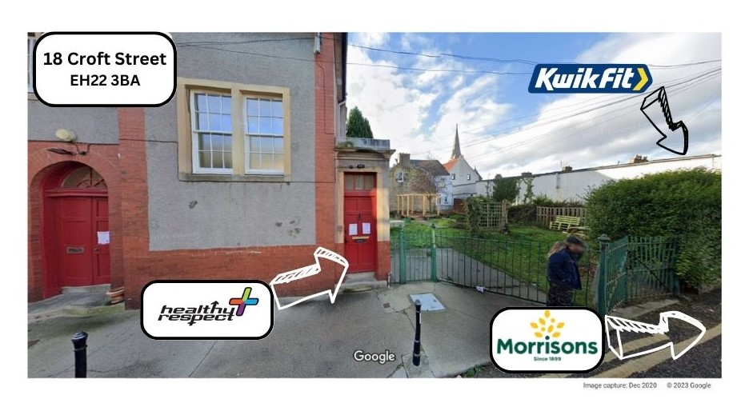
Healthy Respect + young people’s clinic at
Walk past Kwik Fit and the gated garden, next door on your right.
Please note this clinic is accessed via a set of stairs

Slide 16
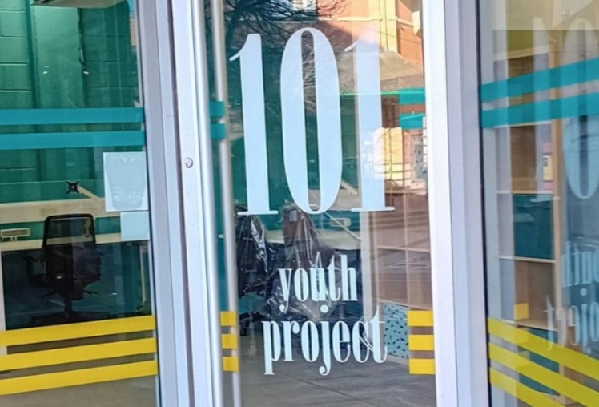
West Lothian
Healthy Respect + young people’s clinic at
101 Youth Project at
The Centre Livingston
Drop-in
Fridays, 1.30pm to 3.30pm
Scan code or find 101.
It is just out past the exit doors where
Costa and Vodaphone are and next door to kidzeco.
Notes:
Individual page so schools can delete

Slide 17
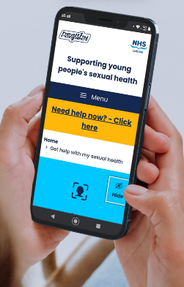
Want to know more about
sexual health and relationships?
Scan code or visit www.healthyrespect.co.uk
Notes:
Introductions. Don’t mention drop-in at this stage as we will come to that later.

